Slide 1


SUMMER INSTITUTIONAL TRAINING
T WEB UI FRAMEWORK AND TOOLS-BOOTSTRAP
PROJECT TOPIC: PORTFOLIO WEBSITE
COURSE BY: COURSERA
SUBMITTED BY: JOTI SHARMA

Slide 2
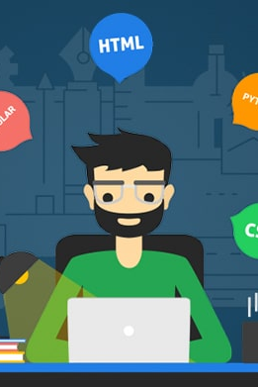
index
INTRODUCTION
TRAINING/LEARNING PROCEDURE
OBJECTIVES
METHODOLOGY
REQUIREMENTS
RESULT/WEBPAGE VIEW
FUTURE SCOPE
REFERENCES

Slide 3

INTRODUCTION

Slide 4
ABOUT PROJECT
Project is based on the learnings from the summer training.
Bootstrap is the most popular framework for developing a responsive and mobile-friendly website.
Very efficient use of the components like HTML, CSS and Bootstrap.
Outcome is a Portfolio website made using the concepts of Bootstrap.
BACKGROUND INFORMATION -
HTML
CSS
BOOTSTRAP

Slide 5

features of html
HTML is the most commonly used language to write web pages. It has recently gained popularity due to its advantages such as: -
It is a language that can be easily understood and can be modified.
HTML is one of the most commonly used languages in the world.
It provides a more flexible way to design web pages along with the text.
HTML is lightweight and loads very fast on most browsers.
HTML is reasonably flexible and has a simple syntax.
Many (if not all) browsers support the use of HTML.

Slide 6

FEATURES OF CSS
CSS Save Time
Page Loads Faster
Easy Maintenance
Superior styles to HTML
Multiple Device Compatibility
Global Web Standards

Slide 7

FEATURES OF BOOSTRAP
Easy to begin with
LESS as Well as CSS Files
Easily Customizable
Responsive Utility Classes
Bootstrap Templates

Slide 8

TRAINING PROCEDURE

Slide 9
TRAINING WORK UNDERTAKEN
Learned different concepts of Full Stack Web Framework.
Made a mini project using the concepts of Bootstrap, HTML and CSS
A fully responsive Portfolio Website using Bootstrap is made.
LEARNING PROCEDURE -
The course offered by Coursera was of 4 weeks.
Week 1 : Learnt basics of full stack, git, bootstrap, features, etc.
Week 2 : Learnt Bootstrap's components likes button, Navbar, Breadcrumb, etc.
Week 3 : Learnt the Bootstrap's components that require JavaScript, JS API, etc.
Week 4 : Learnt and understood the use of JQuery and Bootstrap's JS components, CSS's Less and Sass Codes , etc

Slide 10
Methodology
For creation of this website I learned HTML, CSS from Online resources and Bootstrap framework from summer institutional training. I went through checking various designed portfolio website of others and then came to conclusion of the design I want to give to my own website. And the result was the final portfolio website I created which contains all the required information about myself.

Slide 11


OBJECTIVES AND FUTURE SCOPE

Slide 12

OBJECTIVES
The objective of the project is to create a responsive website using
HTML, CSS, Bootstrap and little bit of JavaScript and for that I have made a Portfolio Website of mine.
SCOPE OF THE PROJECT -
The website is made responsive using buttons, forms, static navigation bar, and other CSS and Bootstrap tools. The website can be even more effective after adding the back-end part to the project so that the data it is collecting goes to the server. Also, after adding more projects and skills it can be hosted as a good professional portfolio website.

Slide 13

requirements

Slide 14
types
Hardware Requirements
Software Requirements
PC with 250GB and more hard disk space
Minimum 2GB RAM
PC with processor Pentium 1 or above
OS: windows XP or further versions
Language: HTML,CSS and Bootstrap
IDE: Visual Studio code
Browser: Google Chrome

Slide 15

RESULT : OVERVIEW OF WEBSITE

Slide 16
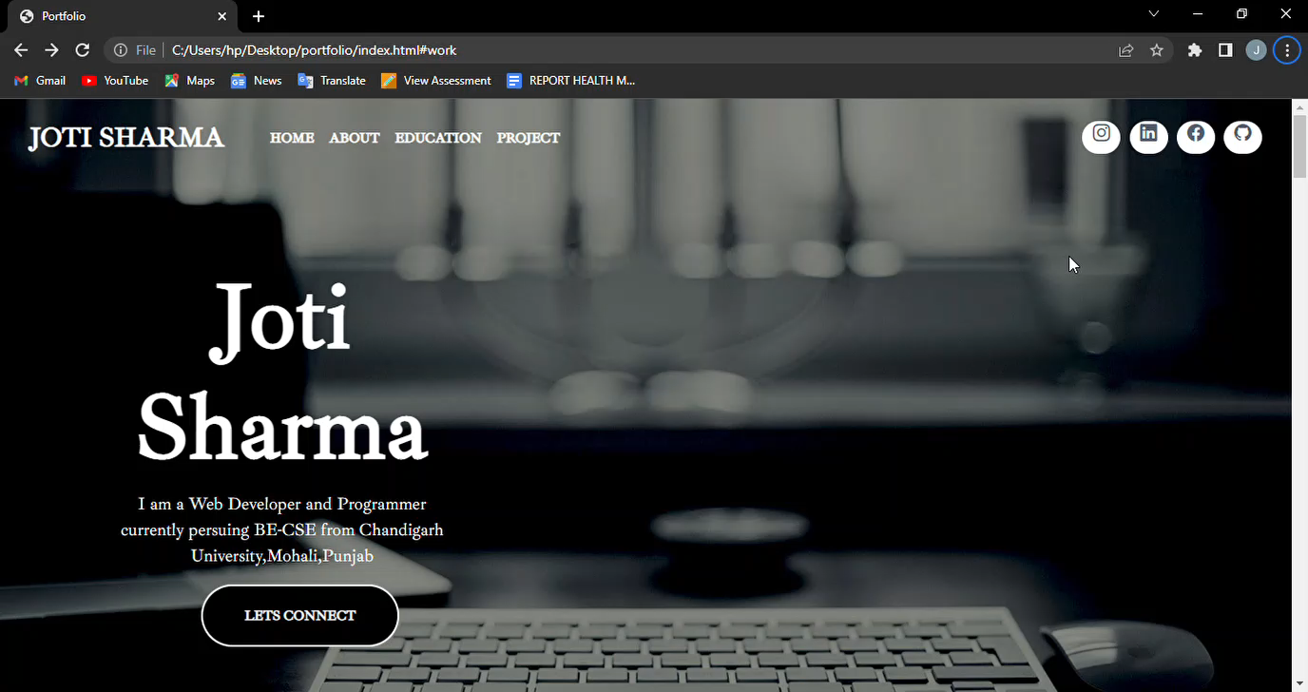

Slide 17

CONCLUSION
The main aim of the project was to create a website using the concepts learned in Institutional/Summer Training and I created a Portfolio website using HTML, CSS and Bootstrap. In this way, my aim is fulfilled. I successfully created a portfolio website in which I displayed all the necessary information that a resume contains , giving all the required details.

Slide 18

REFERENCES
Get Started with Bootstrap [Online]. Available: https://getbootstrap.com/docs/5.2/getting- started/introduction/
Get Started with Bootstrap [Online]. Available: https://getbootstrap.com/docs/5.2/getting- started/introduction/
Stack Overflow [Online]. Available: https://stackoverflow.com/
Youtube [Online]. Available: https://youtube.com/
W3 Schools [Online]. Available: https://www.w3schools.com/default.asp

Slide 19
THANK YOU!!

